Slide 1
https://www.figma.com/file/vdWqMnfZGU3R22JnkgP1qd/MUNELAND?node-id=0%3A1
Go on this URL figma to see the project explained
The two slides here will explain you the insights of the special card design. But go first on the main URL

Slide 2


My profile
Put your Special Card into practice right here. Prepare to impress…
Your Joker
Use this card only when you want to send a specific scope to your main contact. Click on "+" to fill it out before sending.
The freelancer must click here in order to fill it out before sending to his client. See the next screen below.

Slide 3



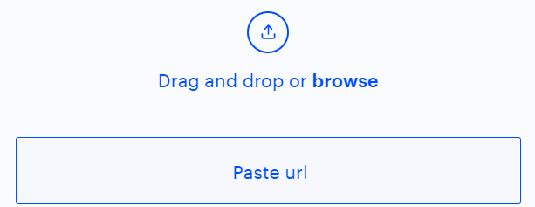

*1. Give a name to the project
*2.
Enter the name of the person you are in contact with
Here are the fields we show when a freelancer click on « + » to fill out his joker card. The « * » means that the field is mandatory. If the freelancer fills in all the required fields, then when he click the "create and submit" button, that card will go to the name of the client he is in contact with
*3. Set the expiry date of this offer
*4. Set the overall cost that you both agree on
*5. Provide some important details of this scope
6. Provide additional details (upload doc, videos, pictures,urls, etc.)

